Slide 1
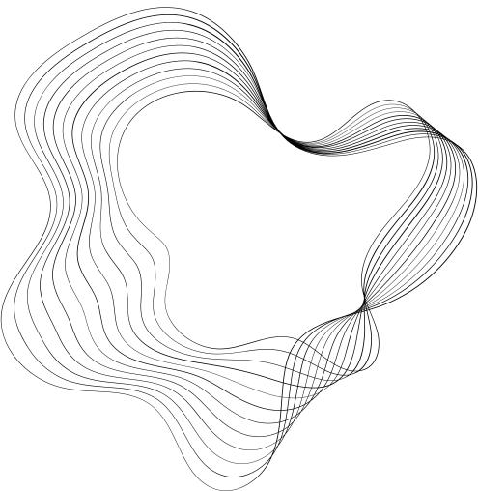

ARTIFICIAL INTELLIGENCE
NETWORK SCANNER ANOMALY DETECTOR
COURSE INSTRUCTOR: MA’AM AQSA UMER
TEAM:
AREESHA AFTAB BCB-23S-042
AFSANA SADIQ BCB-23S-049
ABIHA ZEHRA BCB-22F-039

Slide 2

CONTRIBUTION
AREESHA AFTAB DATA CLEANING
AFSANA SADIQ ALGORITHM
ABIHA ZEHRA NETWORK SCANNING

Slide 3

WORKING
OF THE PROJECT
1)
Real-Time Anomaly Detection
2)
Packet Analysis
3)
Python-Based Implementation

Slide 4
RESOURCES FOR THE PROJECT
IDE
DATASET
JUPYTER NOTEBOOK
NSL-KDD

Slide 5

ALGORITHM
load known attack signature
capture network traffic
start packet capture loop
extract pocket details
check against known attack signatures
Detect anomaly

Slide 6
CODE:
1) DATA CLEANING AND PROCESSING
2) NETWORK SCANNING

Slide 7
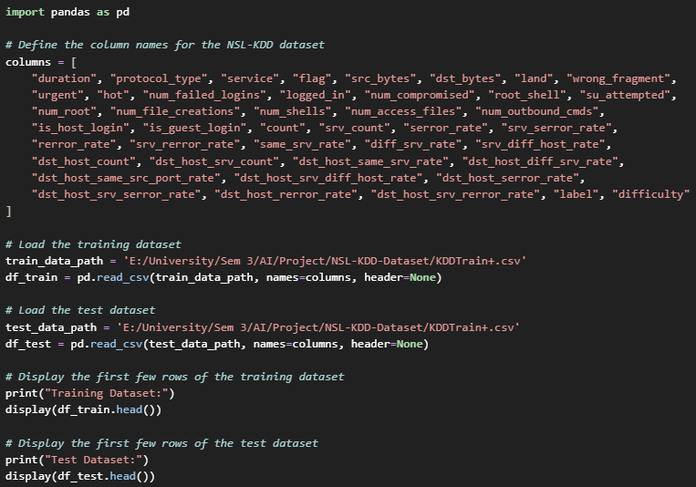
LOAD AND DISPLAY THE
NSL-KDD DATASET

Slide 8
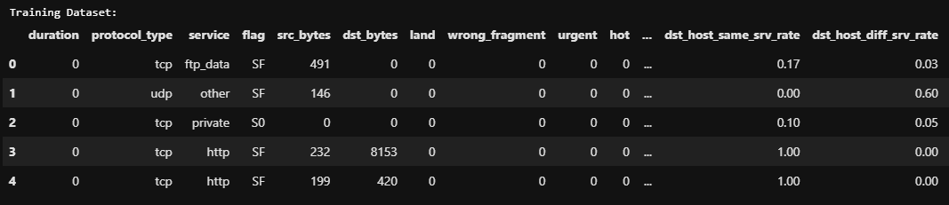
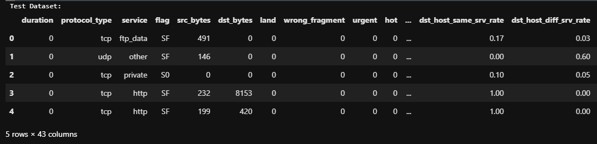

Slide 9
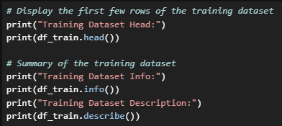
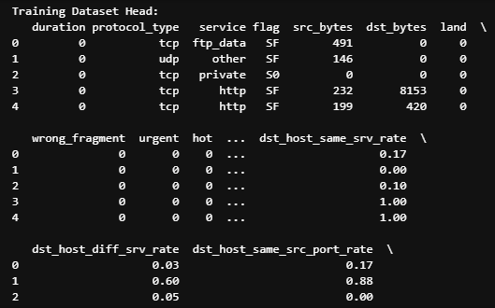
INSPECT THE TRAINING DATASET LOADED

Slide 10
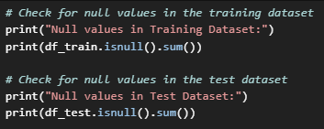
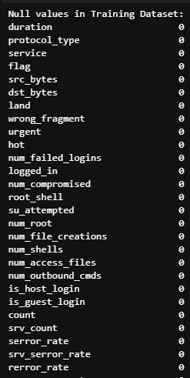
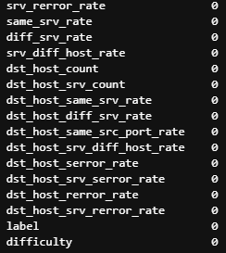
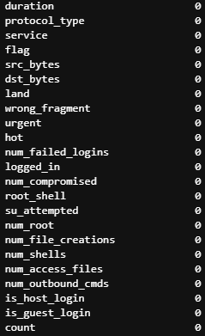
CHECK FOR NULL VALUES IN THE TRAINING AND TEST DATASETS

Slide 11
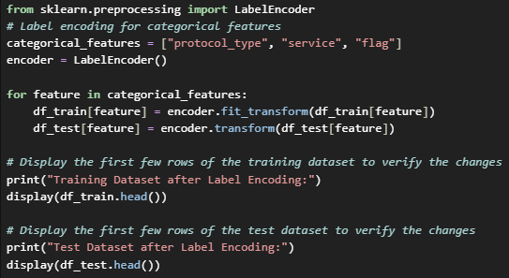
ENCODE CATEGORICAL FEATURES

Slide 12
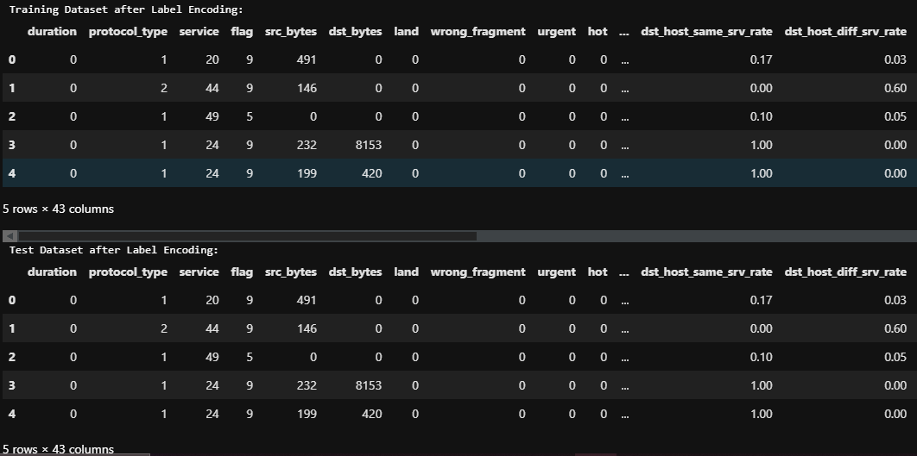

Slide 13
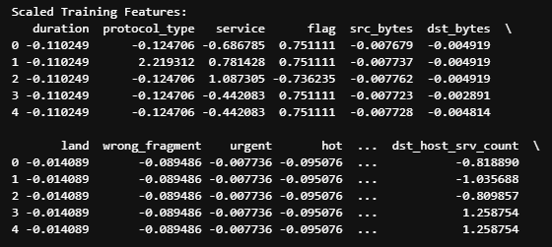
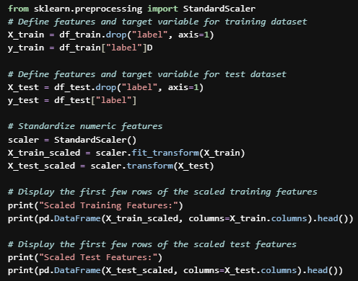
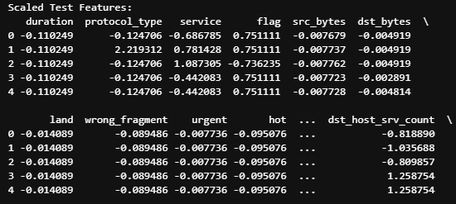
STANDARDIZE NUMERIC FEATURES

Slide 14
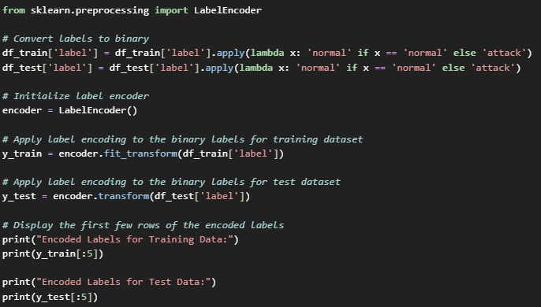

MULTI-CLASS LABELS IN THE DATASET INTO BINARY LABELS

Slide 15
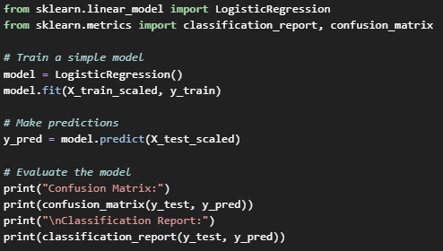
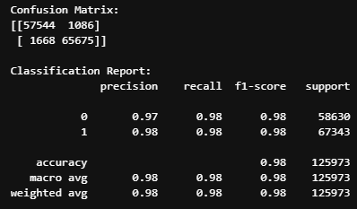
LOGISTIC REGRESSION MODEL ON THE SCALED TRAINING DATASET

Slide 16
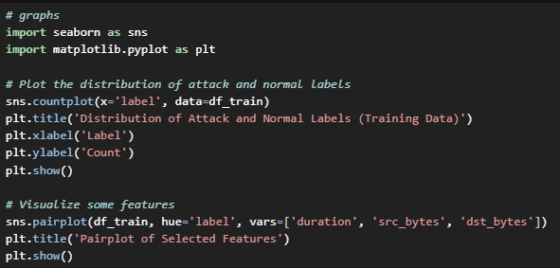
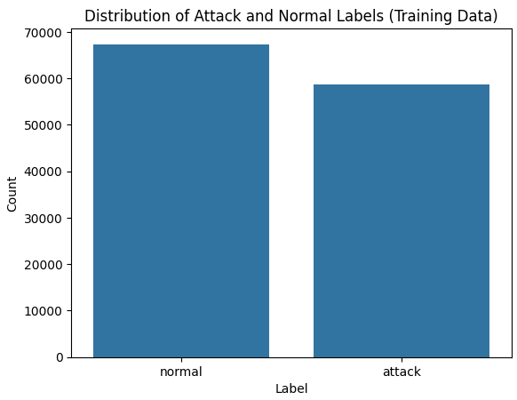
DATA VISUALIZATION

Slide 17
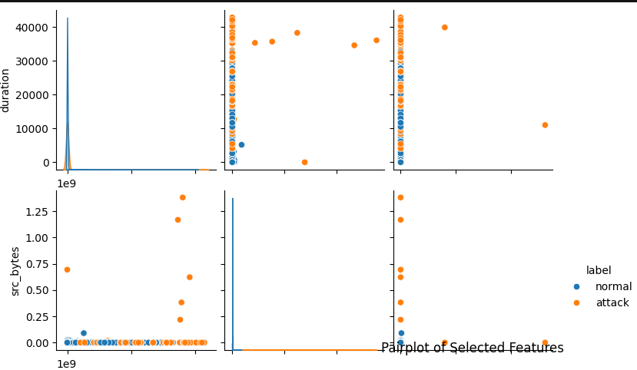
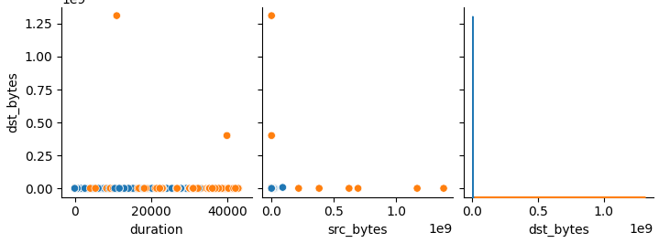

Slide 18
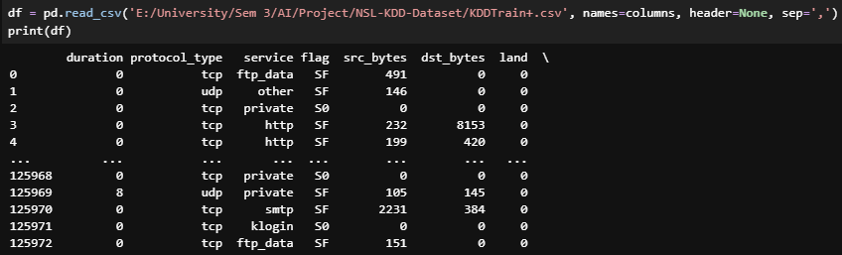
LAST STEP IN DATA CLEANING

Slide 19
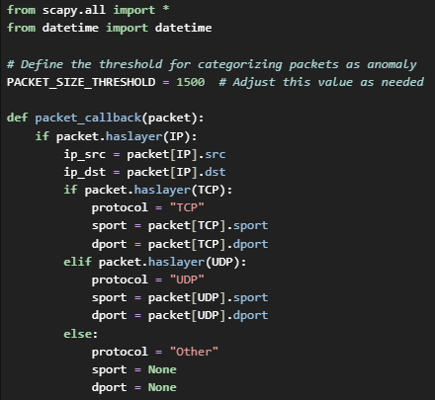
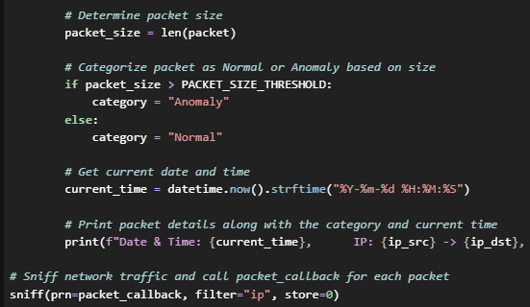
NETWORK
SCANNING

Slide 20
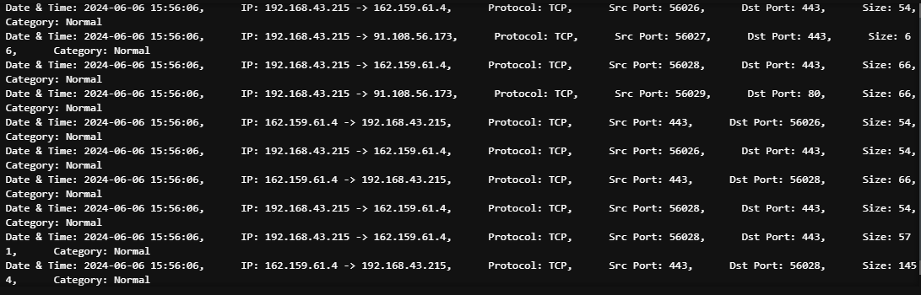

Slide 21

CONCLUSION:
Enhanced Security Posture
Efficient Anomaly Detection
Scalability and Adaptability

